Slide 1
PROCESSES

Slide 2
PROCESSES
The fundamental task of any modern operating system is process management.
The operating system must allocate resources to processes, enable processes to share and exchange information, protect the resources of each process from other processes, and enable synchronization among processes. To meet these requirements, the operating system must maintain a data structure for each process that describes the state and resource ownership of that process and that enables the operating system to exert process control.
The design of an operating system (OS) reflects certain general requirements. All multiprogramming operating systems, from single-user systems such as Windows 98 to mainframe systems such as IBM’s mainframe operating system, z/OS, which can support thousands of users, are built around the concept of the process. Most requirements that the OS must meet can be expressed with reference to processes:
• The OS must interleave the execution of multiple processes, to maximize processor utilization while providing reasonable response time.
• The OS must allocate resources to processes in conformance with a specific policy (e.g., certain functions or applications are of higher priority) while at the same time avoiding deadlock.1
• The OS may be required to support interprocess communication and user creation of processes, both of which may aid in the structuring of applications.

Slide 3
BACKGROUND
1. A computer platform consists of a collection of hardware resources, such as the processor, main memory, I/O modules, timers, disk drives, and so on.
2. Computer applications are developed to perform some task. Typically, they accept input from the outside world, perform some processing, and generate output.
3. It is inefficient for applications to be written directly for a given hardware platform.
The principal reasons for this are as follows:
a. Numerous applications can be developed for the same platform. Thus, it makes sense to develop common routines for accessing the computer’s resources.
b. The processor itself provides only limited support for multiprogramming. Software is needed to manage the sharing of the processor and other
resources by multiple applications at the same time.
c. When multiple applications are active at the same time, it is necessary to protect the data, I/O use, and other resource use of each application from the others.

Slide 4
BACKGROUND
4. The OS was developed to provide a convenient, feature-rich, secure, and consistent interface for applications to use. The OS is a layer of software between the applications and the computer hardware that supports applications and utilities.
5. We can think of the OS as providing a uniform, abstract representation of resources that can be requested and accessed by applications. Resources include main memory, network interfaces, file systems, and so on. Once the OS has created these resource abstractions for applications to use, it must also manage their use. For example, an OS may permit resource sharing and resource protection.
Now that we have the concepts of applications, system software, and resources,we are in a position to discuss how the OS can, in an orderly fashion, manage the execution of applications so that
• Resources are made available to multiple applications.
• The physical processor is switched among multiple applications so all will
appear to be progressing.
• The processor and I/O devices can be used efficiently.

Slide 5
PROCESSES AND PROCESS CONTROL BLOCKS
Definitions of the term process, including
• A program in execution
• An instance of a program running on a computer
• The entity that can be assigned to and executed on a processor
• A unit of activity characterized by the execution of a sequence of instructions, current state, and an associated set of system re
Two essential elements of a process are program code (which may be shared with
other processes that are executing the same program) and a set of data associated
with that code. Let us suppose that the processor begins to execute this program sources code, and we refer to this executing entity as a process. At any given point in time, while the program is executing, this process can be uniquely characterized by a number of elements, including the following

Slide 6
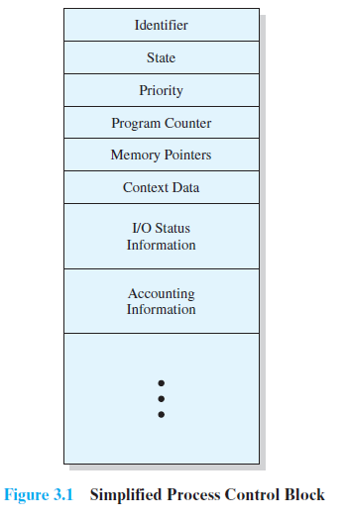


Slide 7
PROCESS STATES
For a program to be executed, a process, or task, is created for that
program. From the processor’s point of view, it executes instructions from its repertoire
in some sequence dictated by the changing values in the program counter register.
Over time, the program counter may refer to code in different programs that
are part of different processes. From the point of view of an individual program, its
execution involves a sequence of instructions within that program.
We can characterize the behavior of an individual process by listing the sequence
of instructions that execute for that process. Such a listing is referred to as a
trace of the process. We can characterize behavior of the processor by showing how
the traces of the various processes are interleaved.

Slide 8
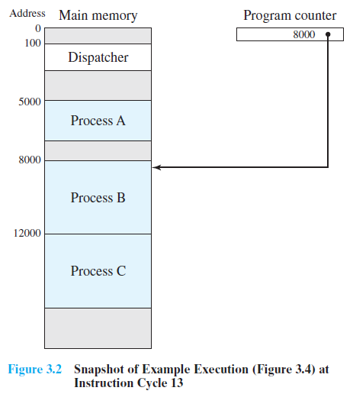
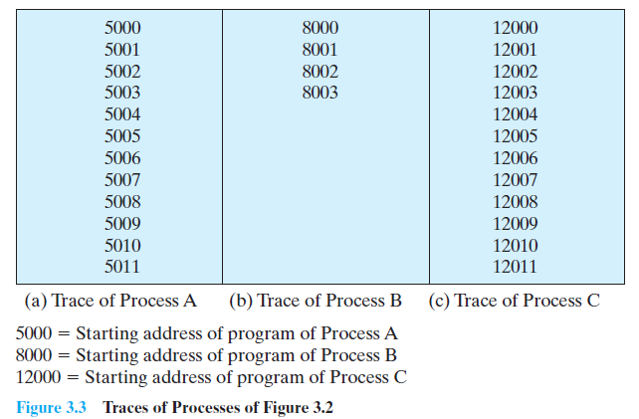
A small dispatcher program that switches the
processor from one process to another.

Slide 9
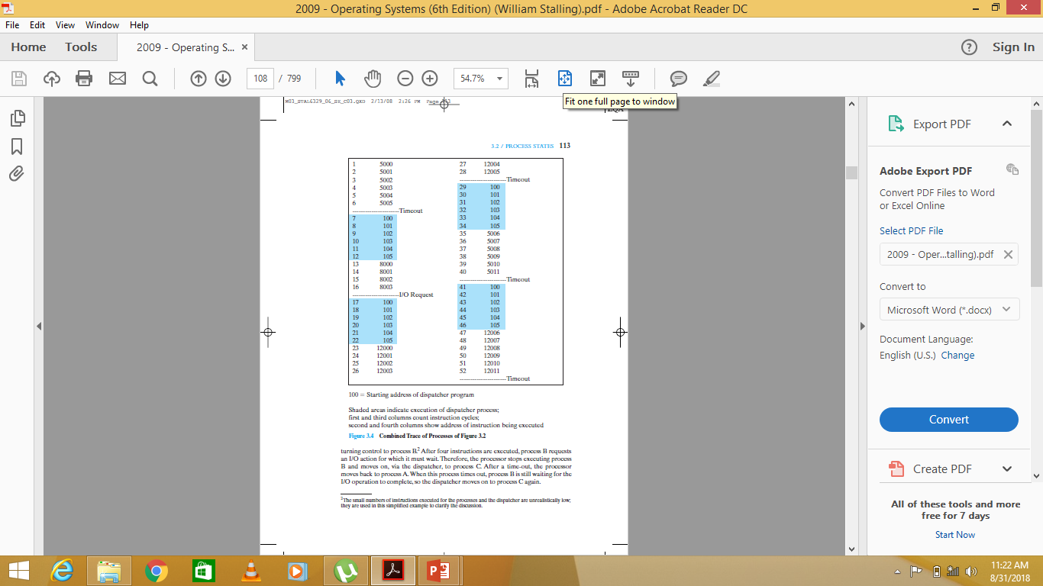

Slide 10
TWO STATE MODEL
We can construct the simplest possible model by observing that, at any time, a
process is either being executed by a processor or not. In this model, a process may
be in one of two states: Running or Not Running, as shown in Figure 3.5a.When the
OS creates a new process, it creates a process control block for the process and enters
that process into the system in the Not Running state. The process exists, is
known to the OS, and is waiting for an opportunity to execute. From time to time,
the currently running process will be interrupted and the dispatcher portion of the
OS will select some other process to run.The former process moves from the Running
state to the Not Running state, and one of the other processes moves to the
Running state.

Slide 11
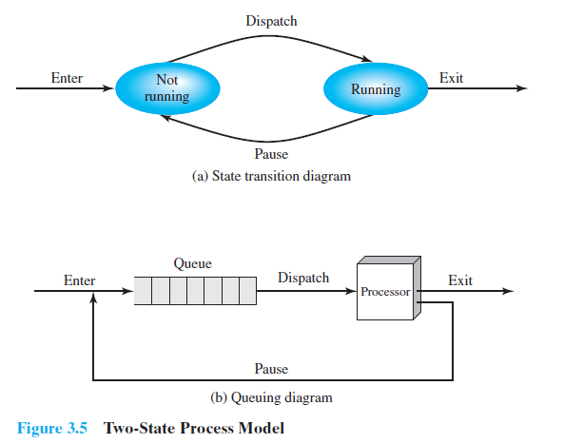

Slide 12
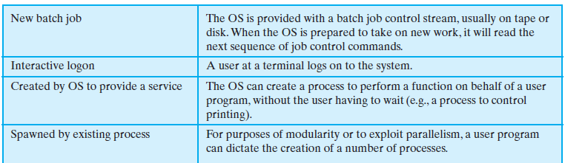
THE CREATION AND TERMINATION OF PROCESSES
Process Creation

Slide 13
PROCESS TERMINATION
Any computer system must provide a means for a process to indicate its completion.
A batch job should include a Halt instruction or an explicit OS service call
for termination. In the former case, the Halt instruction will generate an interrupt to
alert the OS that a process has completed. For an interactive application, the action
of the user will indicate when the process is completed. For example, in a time-sharing
system, the process for a particular user is to be terminated when the user logs off or
turns off his or her terminal. On a personal computer or workstation, a user may
quit an application (e.g., word processing or spreadsheet). All of these actions ultimately result in a service request to the OS to terminate the requesting process.
Additionally, a number of error and fault conditions can lead to the termination
of a process.
Finally, in some operating systems, a process may be terminated by the process
that created it or when the parent process is itself terminated.

Slide 14
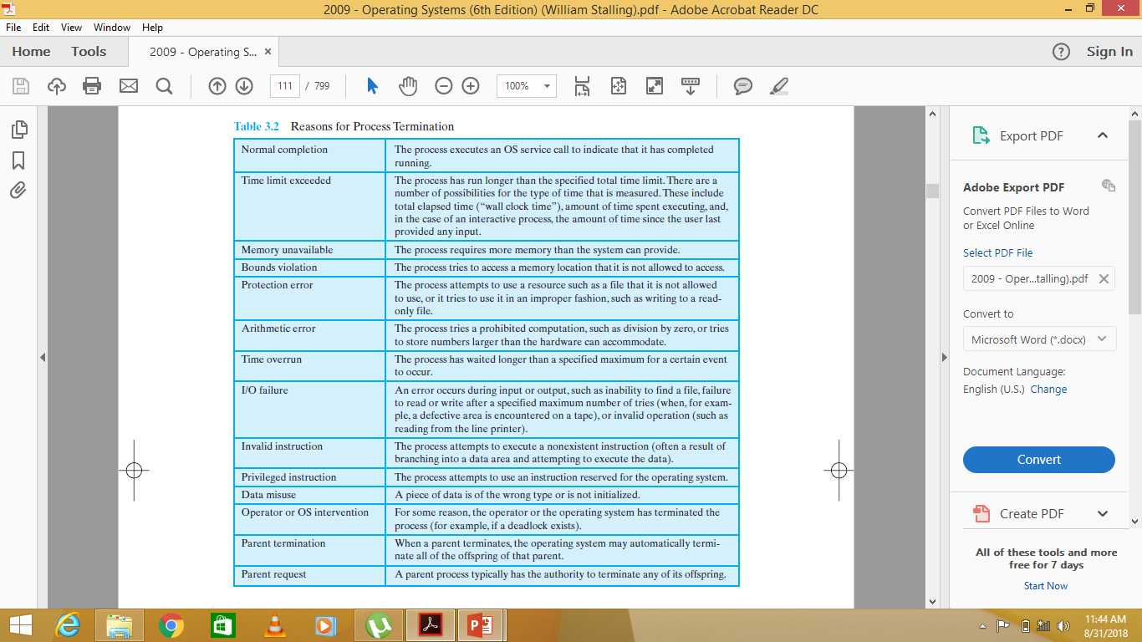

Slide 15
A FIVE-STATE MODEL
Running: The process that is currently being executed. For this chapter, we
will assume a computer with a single processor, so at most one process at a
time can be in this state.
• Ready: A process that is prepared to execute when given the opportunity.
• Blocked/Waiting:4 A process that cannot execute until some event occurs, such
as the completion of an I/O operation.
New: A process that has just been created but has not yet been admitted to the
pool of executable processes by the OS. Typically, a new process has not yet
been loaded into main memory, although its process control block has been
created.
• Exit: A process that has been released from the pool of executable processes
by the OS, either because it halted or because it aborted for some reason.

Slide 16
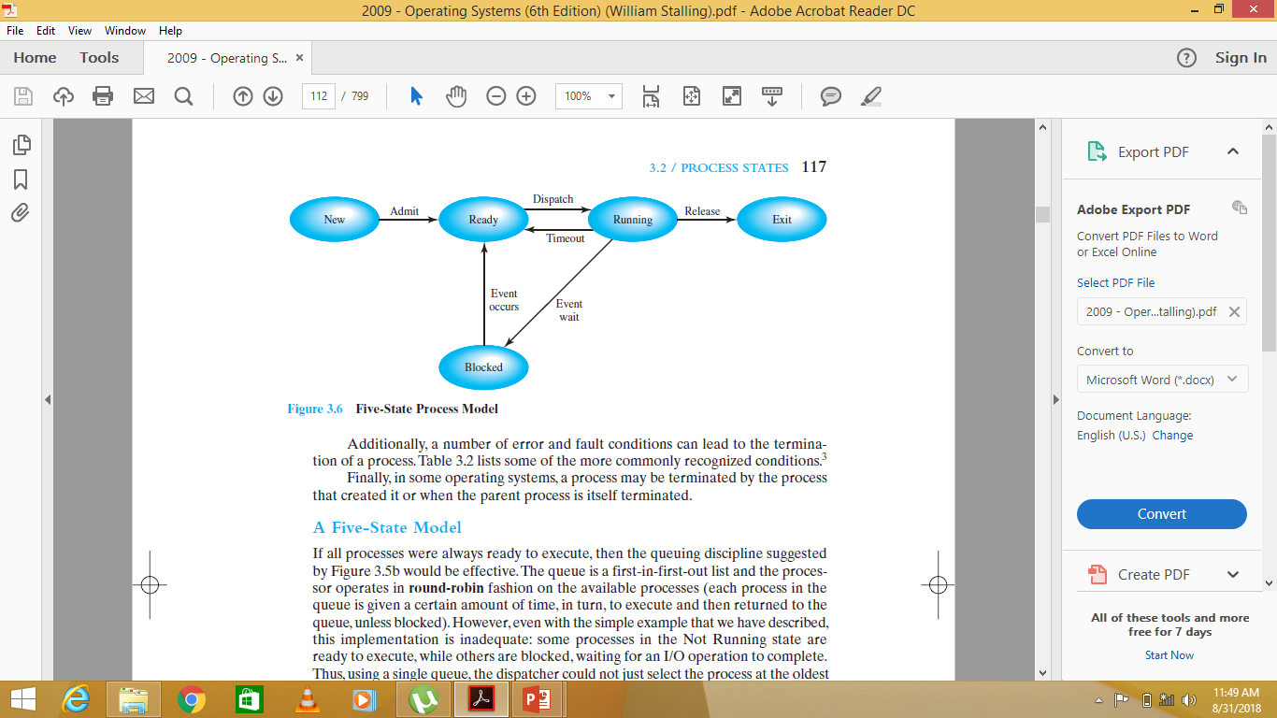

Slide 17
The types of events that lead to each state transition for a
process; the possible transitions are as follows:
• Null →New: A new process is created to execute a program.This event occurs
for any of the reasons listed in Table 3.1.
• New →Ready: The OS ! will move a process from the New state to the Ready
state when it is prepared to take on an additional process.

Slide 18
• Ready → Running: When it is time to select a process to run, the OS chooses one of the processes in the Ready state. This is the job of the scheduler or dispatcher.
• Running →Exit: The currently running process is terminated by the OS if the process indicates that it has completed, or if it aborts. See Table 3.2.
• Running →Ready: The most common reason for this transition is that the running process has reached the maximum allowable time for uninterrupted execution; virtually all multiprogramming operating systems impose this type of time discipline. There are several other alternative causes for this transition, which are not implemented in all operating systems. Of particular importance is the case in which the OS assigns different levels of priority to different processes. Suppose, for example, that process A is running at a given priority level, and process B, at a higher priority level, is blocked. If the OS learns that the event upon which process B has been waiting has occurred, moving B to a ready state, then it can interrupt process A and dispatch process B. We say that the OS has preempted process A.6 Finally, a process may voluntarily release control of the processor. An example is a background process that performs some accounting or maintenance function periodically.

Slide 19
Running →Blocked: A process is put in the Blocked state if it requests something
for which it must wait. A request to the OS is usually in the form of a system service call; that is, a call from the running program to a procedure that is part of the operating system code.
• Blocked →Ready: A process in the Blocked state is moved to the Ready state when the event for which it has been waiting occurs.
• Ready→Exit: For clarity, this transition is not shown on the state diagram. In some systems, a parent may terminate a child process at any time. Also, if a parent terminates, all child processes associated with that parent may be terminated.

Slide 20
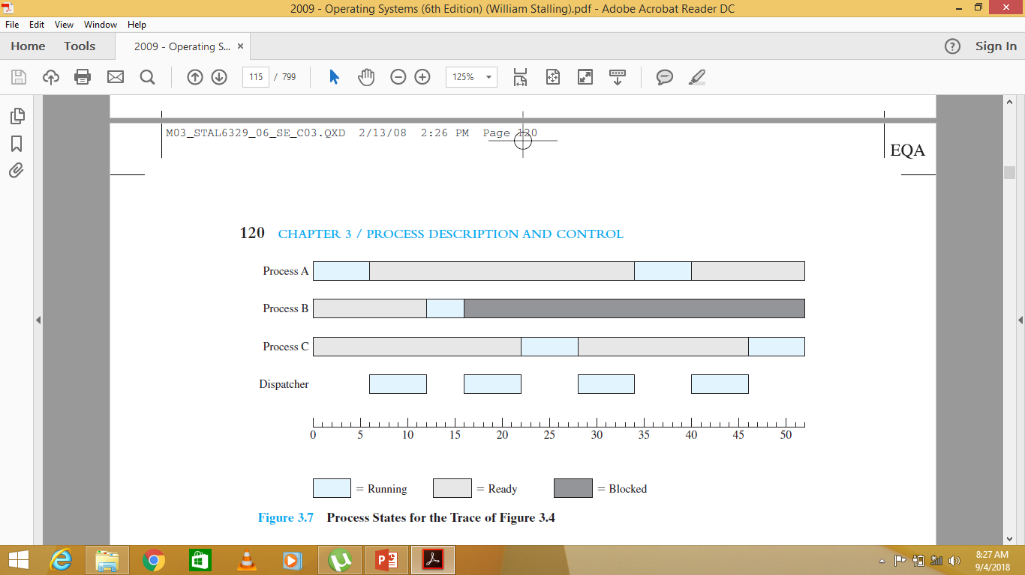
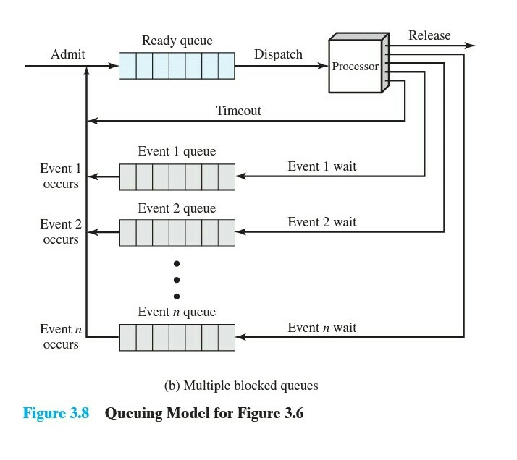
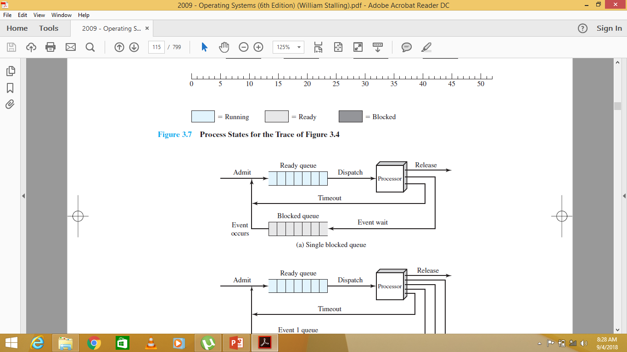

Slide 21
SUSPENDED PROCESSES
The Need for Swapping The three principal states just described (Ready,Running, Blocked) provide a systematic way of modeling the behavior of processes and guide the implementation of the OS. Some operating systems are constructed using just these three states.
Each process to be executed must be loaded fully into main memory. Thus, in Figure 3.8b, all of the processes in all of the queues must be resident in main memory.

Slide 22
What to do? Main memory could be expanded to accommodate more processes.
But there are two flaws in this approach.
First, there is a cost associated with main memory, which, though small on a per-byte basis, begins to add up as we get into the gigabytes of storage. Second, the appetite of programs for memory has grown as fast as the cost of memory has dropped. So larger memory results in larger processes, not more processes.
Another solution is swapping,
which involves moving part or all of a process from main memory to disk. When none of the processes in main memory is in the Ready state, the OS swaps one of the blocked processes out onto disk into a suspend queue. This is a queue of existing processes that have been temporarily kicked out of main memory, or suspended. The OS then brings in another process from the suspend queue, or it honors a new-process request. Execution then continues with the newly arrived process.

Slide 23
• Ready: The process is in main memory and available for execution.
• Blocked: The process is in main memory and awaiting an event.
• Blocked/Suspend: The process is in secondary memory and awaiting an event.
• Ready/Suspend: The process is in secondary memory but is available for execution as soon as it is loaded into main memory.
Blocked →Blocked/Suspend: If there are no ready processes, then at least one blocked process is swapped out to make room for another process that is not blocked. This transition can be made even if there are ready processes available, if the OS determines that the currently running process or a ready process that it would like to dispatch requires more main memory to maintain adequate performance.
Blocked/Suspend → Ready/Suspend: A process in the Blocked/Suspend state is moved to the Ready/Suspend state when the event for which it has been waiting occurs. Note that this requires that the state information concerning suspended processes must be accessible to the OS.

Slide 24
• Ready/Suspend → Ready: When there are no ready processes in main memory,
the OS will need to bring one in to continue execution. In addition, it might be the
case that a process in the Ready/Suspend state has higher priority than any of the
processes in the Ready state. In that case, the OS designer may dictate that it is
more important to get at the higher-priority process than to minimize swapping.
• Ready →Ready/Suspend: Normally, the OS would prefer to suspend a blocked
process rather than a ready one, because the ready process can now be executed,
whereas the blocked process is taking up main memory space and cannot be
executed. However, it may be necessary to suspend a ready process if that is
the only way to free up a sufficiently large block of main memory. Also, the OS
may choose to suspend a lower-priority ready process rather than a higher priority
blocked process if it believes that the blocked process will be ready soon.

Slide 25
PROCESS CONTROL
Modes of Execution
Most processors support at least two modes of execution. Certain instructions can only be executed in the more-privileged mode.These would include reading or altering a control register, such as the program status word; primitive I/O instructions; and instructions that relate to memory management.In addition,certain regions of memory can only be accessed in the more-privileged mode. The less-privileged mode is often referred to as the user mode, because user programs typically would execute in this mode. The more-privileged mode is referred to as the system mode ,control mode,or kernel mode.This last term refers to the kernel of the OS, which is that portion of the OS that encompasses the important system functions.

Slide 26
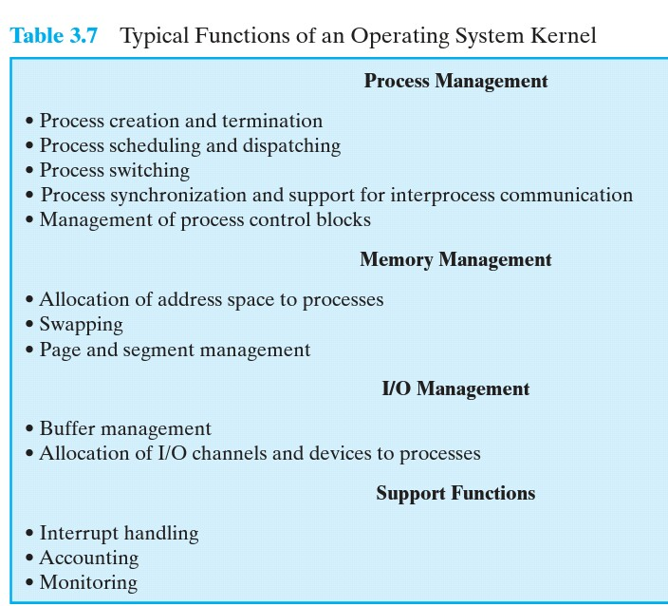
There is a bit in the program status word (PSW) that indicates the mode of execution.This bit is changed in response to certain events.Typically, when a user makes a call to an operating system service or when an interrupt triggers execution of an operating system routine, the mode is set to the kernel mode and, upon return from the service to the user process,the mode is set to user mode

Slide 27
When an interrupt occurs, the processor clears most of the bits in the psr, including the cpl field.This automatically sets the cpl to level 0. At the end of the interrupt-handling routine, the final instruction that is executed is irt (interrup return). This instruction causes the processor to restore the psr of the interrupted program, which restores the privilege level of that program.

Slide 28
PROCESS CREATION
To create a new process, it can proceed as follows:
1. Assign a unique process identifier to the new process. At this time,a new entry is added to the primary process table, which contains one entry per process.
2. Allocate space for the process. The OS must know how much space is needed for the private user's programs and data.These values can be assigned by default based on the type of process,or they can be set based on user request at job creation time. If a process is spawned by another process,the parent process can pass the needed values to the OS . If any existing address space is to be shared by this new process,the appropriate linkages must be set up.Finally,space for a process control block must be allocated.
3. Initialize the process control block. The process identification portion contains the ID of this process plus other appropriate IDs, such as that of the parent process.The processor state information portion will typically be initialized with most entries zero, except for the program counter and system stack pointers .The process control information portion is initialized based on standard default values plus attributes that have been requested for this process.

Slide 29
4. Set the appropriate linkages. For example, if the OS maintains each scheduling queue as a linked list, then the new process must be put in the Ready or Ready/Suspend list.
5. Create or expand other data structures. For example, the OS may maintain an accounting file on each process to be used subsequently for billing and/or performance assessment purposes.

Slide 30
PROCESS SWITCHING
A running process is interrupted and the OS assigns another process to the Running state and turns control over that process.
Process switch is a operating system scheduler change from one running program to another. This requires saving all of the state of the currently executing program, including its register state, associated kernel state, and all of its virtual memory configuration. All of the state of the new program is then loaded and execution continues.

Slide 31
WHEN TO SWITCH PROCESSES
A process switch may occur any time that the OS has gained control from the currently running process. we can distinguish, as many systems do, two kinds of system interrupts, one of which is simply referred to as an interrupt, and the other as a trap.The former is due to some sort of event that is external to and independent of the currently running process, such as the completion of an I/O operation.The latter relates to an error or exception condition generated within the currently running process, such as an illegal file access attempt. With an ordinary interrupt, control is first transferred to an interrupt handler, which does the particular type of interrupt that has occurred.
Examples include the following:

Slide 32
• Clock interrupt: The OS determines whether the currently running process has been executing for the maximum allowable unit of time, referred to as a time slice. That is, a time slice is the maximum amount of time that a process can execute before being interrupted. If so, this process must be switched to a Ready state and another process dispatched.
• I/O interrupt: The OS determines what I/O action has occurred. If the I/O action constitutes an event for which one or more processes are waiting,then the OS moves all of the corresponding blocked processes to the Ready state . The OS must then decide whether to resume execution of the process currently in the Running state or to preempt that process for a higher-priority Ready process.
• Memory fault: The processor encounters a virtual memory address reference for a word that is not in main memory.The OS must bring in the block of memory containing the reference. After the I/O request is issued to bring in the block of memory, the process with the memory fault is placed in a blocked state; the OS then performs a process switch to resume execution of another process. After the desired block is brought into memory, that process is placed in the Ready state.

Slide 33
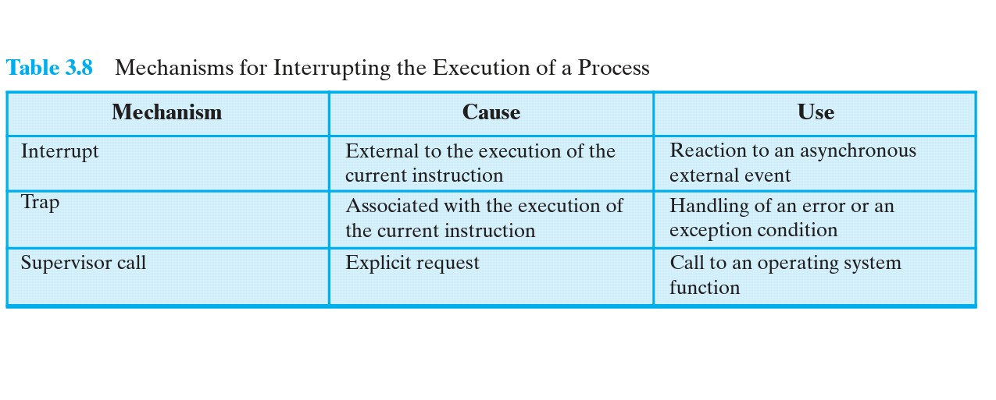

Slide 34
MODE SWITCHING
If no interrupts are pending, the processor proceeds to the fetch stage and fetches the next instruction of the current program in the current process. If an interrupt is pending, the processor does the following:
It sets the program counter to the starting address of an interrupt handler program.
It switches from user mode to kernel mode so that the interrupt processing code may include privileged instructions.

Slide 35
CHANGE OF PROCESS STATE
The steps involved in a full process switch are as follows:
Save the context of the processor, including program counter and other registers.
Update the process control block of the process that is currently in the Running state. This includes changing the state of the process to one of the other states .Other relevant fields must also be updated, including the reason for leaving the Running state and accounting information.
Move the process control block of this process to the appropriate queue.
Select another process for execution;this topic is explored in Part Four
Update the process control block of the process selected.This includes changing the state of this process to Running.
Update memory management data structures.This may be required, depending on how address translation is managed.
Restore the context of the processor to that which existed at the time the selected process was last switched out of the Running state, by loading in the previous values of the program counter and other registers.

Slide 36
INTERPROCESS COMMUNICATION
Processes within a system may be independent or cooperating
Independent process cannot affect or be affected by the execution of another process
Cooperating process can affect or be affected by other processes, including sharing data
Reasons for allowing cooperation of processes:
  Information sharing→provide concurrent access to shared information
  Computation speedup→task divided in subtask to execute in parallel
  Modularity→dividing system functions in processes or threads
  Convenience→individual may work on many tasks at same time
Cooperating processes need interprocess communication (IPC)
Two models of IPC
  Shared memory
  Message passing

Slide 37

COMMUNICATIONS MODELS
(a) Message passing. (b) shared memory.

Slide 38
INTERPROCESS COMMUNICATION
– SHARED MEMORY
An area of memory shared among the processes that wish to communicate
The communication is under the control of the users processes not the operating system.
Major issues is to provide mechanism that will allow the user processes to synchronize their actions when they access shared memory.
Synchronization is discussed in great details in next Chapter.

Slide 39
INTERPROCESS COMMUNICATION
–MESSAGE PASSING
Mechanism for processes to communicate and to synchronize their actions
Message system – processes communicate with each other without resorting to shared variables
IPC facility provides two operations:
  send(message)
  receive(message)
The message size is either fixed or variable

Slide 40
MESSAGE PASSING (CONT.)
If processes P and Q wish to communicate, they need to:
  Establish a communication link between them
  Exchange messages via send/receive
Implementation issues:
  How are links established?
  Can a link be associated with more than two processes?
  How many links can there be between every pair of communicating processes?
  What is the capacity of a link?
  Is the size of a message that the link can accommodate fixed or variable?
  Is a link unidirectional or bi-directional?

Slide 41
MESSAGE PASSING (CONT.)
Implementation of communication link
  Physical:
    Shared memory
    Hardware bus
    Network
  Logical:
    Direct or indirect
    Synchronous or asynchronous
    Automatic or explicit buffering

Slide 42
DIRECT COMMUNICATION
Processes must name each other explicitly:
  send (P, message) – send a message to process P
  receive(Q, message) – receive a message from process Q
Properties of communication link
  Links are established automatically
  A link is associated with exactly one pair of communicating processes
  Between each pair there exists exactly one link
  The link may be unidirectional, but is usually bi-directional

Slide 43
INDIRECT COMMUNICATION
Messages are directed and received from mailboxes (also referred to as ports)
  Each mailbox has a unique id
  Processes can communicate only if they share a mailbox
Properties of communication link
  Link established only if processes share a common mailbox
  A link may be associated with many processes
  Each pair of processes may share several communication links
  Link may be unidirectional or bi-directional

Slide 44
INDIRECT COMMUNICATION
Operations
  create a new mailbox (port)
  send and receive messages through mailbox
  destroy a mailbox
Primitives are defined as:
send(A, message) – send a message to mailbox A
receive(A, message) – receive a message from mailbox A

Slide 45
INDIRECT COMMUNICATION
Mailbox sharing
  P₁, P₂, and P₃ share mailbox A
  P₁, sends; P₂ and P₃ receive
  Who gets the message?
Solutions
  Allow a link to be associated with at most two processes
  Allow only one process at a time to execute a receive operation
  Allow the system to select arbitrarily the receiver. Sender is notified who the receiver was.

Slide 46
SYNCHRONIZATION
Message passing may be either blocking or non-blocking
Blocking is considered synchronous
  Blocking send -- the sender is blocked until the message is received
  Blocking receive -- the receiver is blocked until a message is available
Non-blocking is considered asynchronous
  Non-blocking send -- the sender sends the message and continue
  Non-blocking receive -- the receiver receives:
    A valid message, or
    Null message
Different combinations possible
  If both send and receive are blocking, we have a rendezvous

Slide 47
PIPES
Acts as a duct allowing two processes to communicate
Ordinary pipes – cannot be accessed from outside the process that created it. Typically, a parent process creates a pipe and uses it to communicate with a child process that it created.
Named pipes – can be accessed without a parent-child relationship.

Slide 48

ORDINARY PIPES
Ordinary Pipes allow communication
Producer writes to one end (the write-end of the pipe)
Consumer reads from the other end (the read-end of the pipe)
Ordinary pipes are therefore unidirectional
Require parent-child relationship between communicating processes
Windows calls these anonymous pipes

Slide 49
NAMED PIPES
Named Pipes are more powerful than ordinary pipes
Communication is bidirectional
No parent-child relationship is necessary between the communicating processes
Several processes can use the named pipe for communication
Provided on both UNIX and Windows systems

